Slide 1
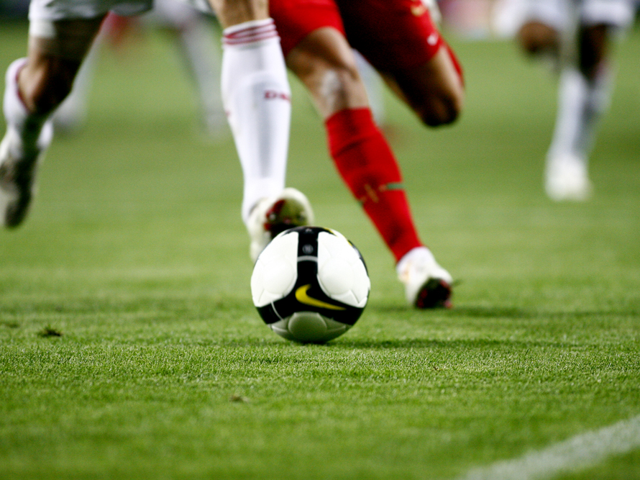
FOOTBALL
This Photo by Unknown Author is licensed under CC BY-SA

Slide 2
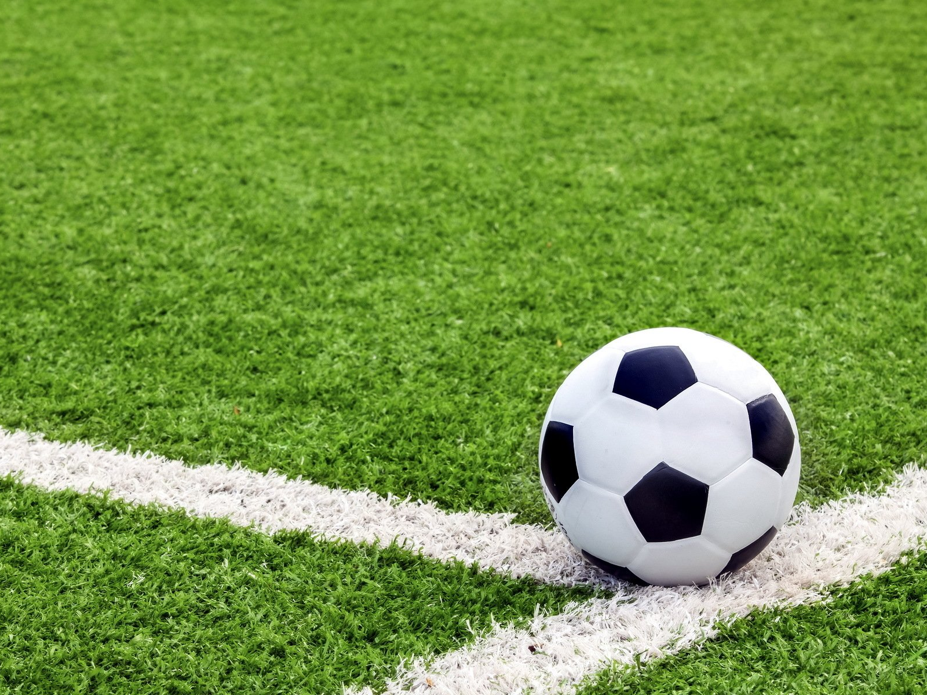
INTRODUCTION
Football is a dynamic sport played between two teams, where the goal is to score by getting the ball into the opposing team's net. It’s a game of strategy, skill, and teamwork, enjoyed by millions around the world.

Slide 3
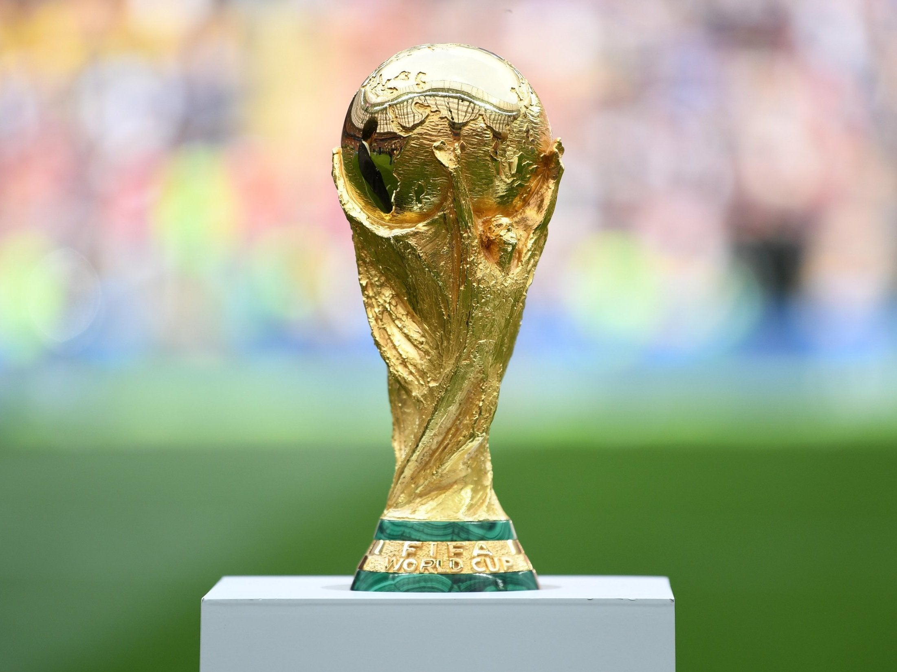
WORLD CUP the most iconic football tournament
Country | Brazil | Argentina | Uruguay | Spain
World Cups | 5 | 3 | 2 | 1

Slide 4
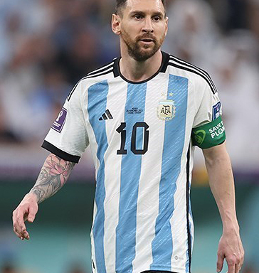
THE ICON
Lionel Messi, with his unmatched skill, record-breaking achievements, and seven Ballon d'Or awards, is the face of modern football. His incredible talent, consistency, and humility have made him a global icon and a true representative of the sport.
This Photo by Unknown Author is licensed under CC BY-SA

